Slide 1
Visualization

Slide 2
Why focus on Graphics?
Visualization belongs in every stage of the data life cycle
Plots can uncover structure in data that can’t be detected from numerical summaries
Alternative approach to learning the method of comparison, variation, distribution
Visualization is an important communication skill

Slide 3
Students will be able to:
Carry out Exploratory Data Analysis to uncover structure in data
Use data visualizations as a first step in modeling
Integrate the use of graphics through out the analysis process, including confirmatory and reporting stages

Slide 4
Students will be able to:
Describe a statistical graph using common vocabulary
Read and think critically about a graph
Create a visualization that conveys key points of an analysis

Slide 5
Technical Skills
Entry point and motivation for learning statistical software
Create presentation quality statistical graphs, including appropriate use of scale, color, labels, reference markers

Slide 6
Assignments
A first exploratory assignment
Deconstruct – Reconstruct
Turn tables into plots
One-minute revelation
Mashup/New form of visual presentation (advanced)
Copy the Masters (advanced)
See Ch 4 Statistical Graphs, Teaching Statistics (Gelman & Nolan)

Slide 7
Lecture Materials

Slide 8
The Variable Represents
Urban Dictionary:
Go and be a good example to the others of your group or in your position
Huh?
A Variable represents a feature
It is distinct from it’s coding in a data file or data frame. It is more than a column in a table.

Slide 9
Variable
Note that categorical variable can have numeric levels and quantitative variables may be stored as strings.
Ratios and intervals have meaning.
Quantitative
Qualitative
Continuous
Discrete
Ordinal
Nominal
Could be measured to arbitrary precision.
Finite possible values
Categories w/ levels but no consistent meaning to difference
Categories w/ no
specific ordering.
Examples:
Price
Temperature
Examples:
Number of siblings
Yrs of education
Examples:
Preferences
Level of education
Examples:
Political Affiliation
CalD number

Slide 10
Variable Represents → Plot Type
Type | Plot
Quantitative – | Histogram, Density curve Box plot, Violin plot Normal quantile plot Few Observations - Rug plot, Dot plot Caution if discrete: density curves and box plots may be misleading
Qualitative – Counts of categories | Dot chart Bar chart Pie chart (avoid!) Caution if ordinal –order of bars, dots, etc. should reflect category order

Slide 11
Variable Represents → Plot Type
 | Quantitative | Qualitative
Quantitative | Scatter plot Smooth scatter Contour plot Smooth lines and curves | Multiple histograms, density curves, Avoid jiggling!
Qualitative |  | Side-by-side bar plot Overlaid Lines plot Side-by-side dot chart Mosaic plot Avoid stacking!

Slide 12
ggplot model
Based on the Grammar of Graphics

Slide 13
Three Basic Elements of a ggplot
Aesthetic mapping - connects variables in a data frame to features of the plot
Layers – plots are created in layers
Themes - customizes the non-data components of the plot

Slide 14
Aesthetic Mapping
y – y-axis
x – x-axis
color – color of points, lines, etc.
group – conditioning/subsetting

Slide 15
Layers
geoms – geometric shapes, e.g.,
geom_point – layers on points for a scatter plot
geom_smooth – layers on a smooth line or curve
geom_histogram, geom_density, geom_boxplot, geom_bar
scale - control the scales of data components
x and y axis scale for specifying the limits and labels for axes
color palettes for the color scale and labels for legends
Annotate - adds fixed reference information

Slide 16
Themes
Change overall theme, e.g.,
theme_bw– black and white theme
theme_classic – base R graphics appearance
Tweak
Location of a legend
Grid lines
Font size and type

Slide 17
Case: Infant Health
load(url("http://www.stat.berkeley.edu/users/nolan/data/babies.Rda"))
Or. load("./data/babies.Rda")

Slide 18
Kaiser Study
Oakland Kaiser mothers
1960s
Measure the babies weight (in ounces) at birth
All babies:
Male
Single births (no twins, etc.)
Survived 28 days

Slide 19
Information collected on mother’s and their babies
Birth weight (ounces)
Gestation (weeks)
Parity - total number of previous pregnancies
Mother’s height and weight
Mother’s smoking status
Mother’s age, race, education level, income
And more…

Slide 20
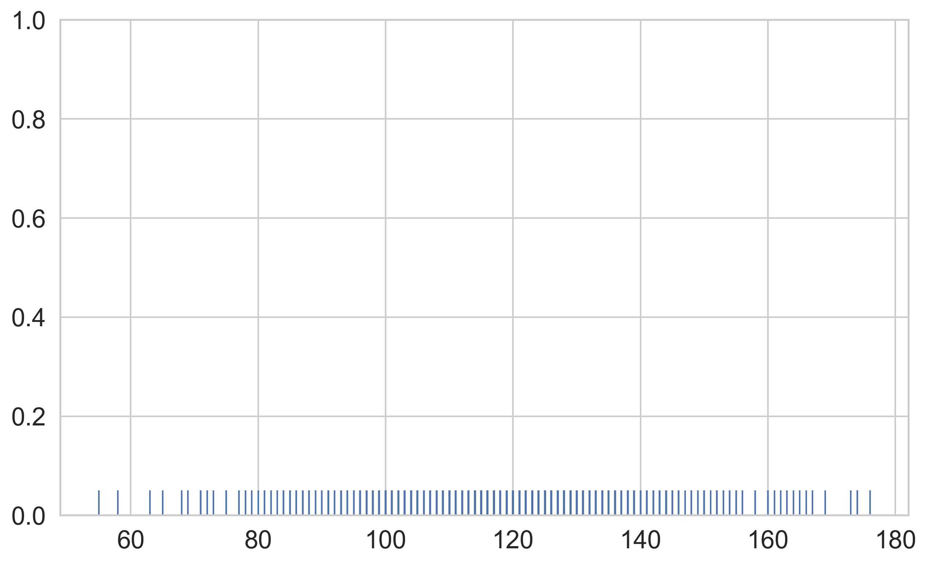
Quantitative – Continuous
Birthweight
The most basic visual representation of one quantitative variable is the rug plot
Hard to see much of the distribution with this rug plot

Slide 21
Histograms and Density Curves
Describes distribution of data – relative prevalence of values
Histogram
relative frequency of values
Tradeoff of bin sizes
Rug Plot
Shows the actual data locations
Smoothed density estimator
Tradeoff of “bandwidth” parameter (more on this later)
Main Mode
Smoothed Density Estimator
Second Mode
Skew Right
Histogram
Outliers
Gap
Rug

Slide 22
Box Plot
Useful for comparing multiple distributions
Outliers
Outliers are more than 1.5 * IQR away from lower and upper quartiles.
Wisker
Upper Quartile
Visualization of summary statistics
Interquartile
Range (IQR)
50% of Data
Median
Can lose a lot of features, such as…?
Lower Quartile
Notes:
(1) Friday non-smokers seem to have higher bills

Slide 23
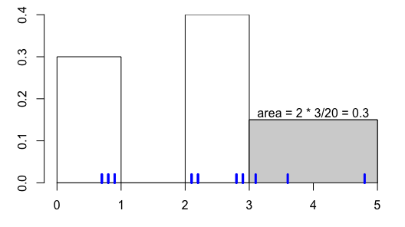
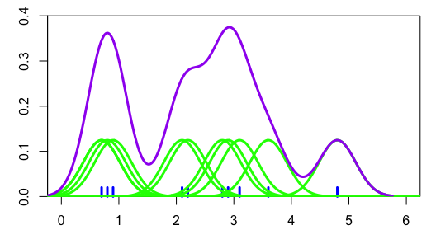
Histogram & Density Curve – both smooth
0.7, 0.8, 0.9, 2.1, 2.2, 2.8, 2.9, 3.1, 3.6, 4.8

Slide 24
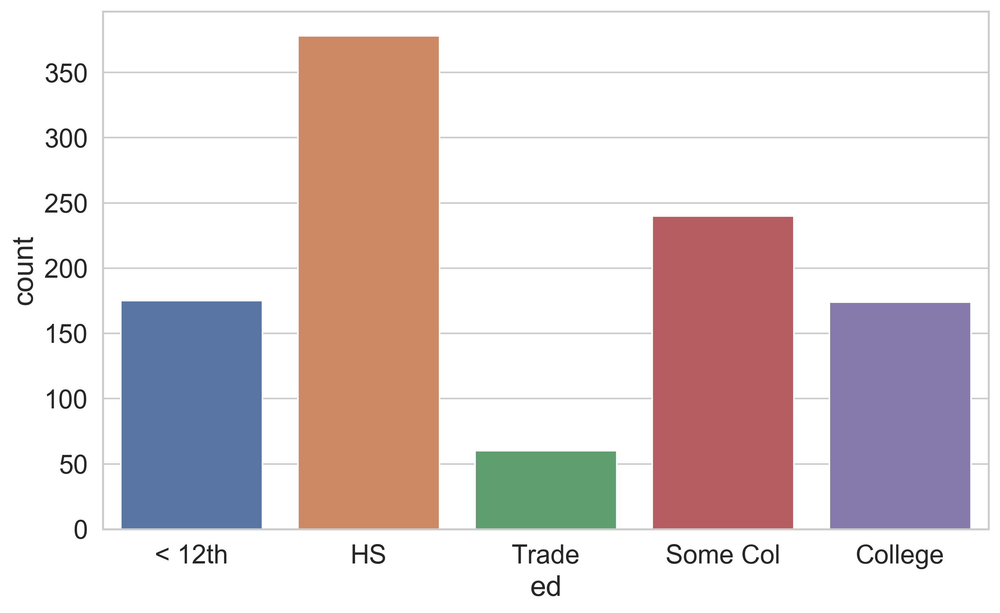
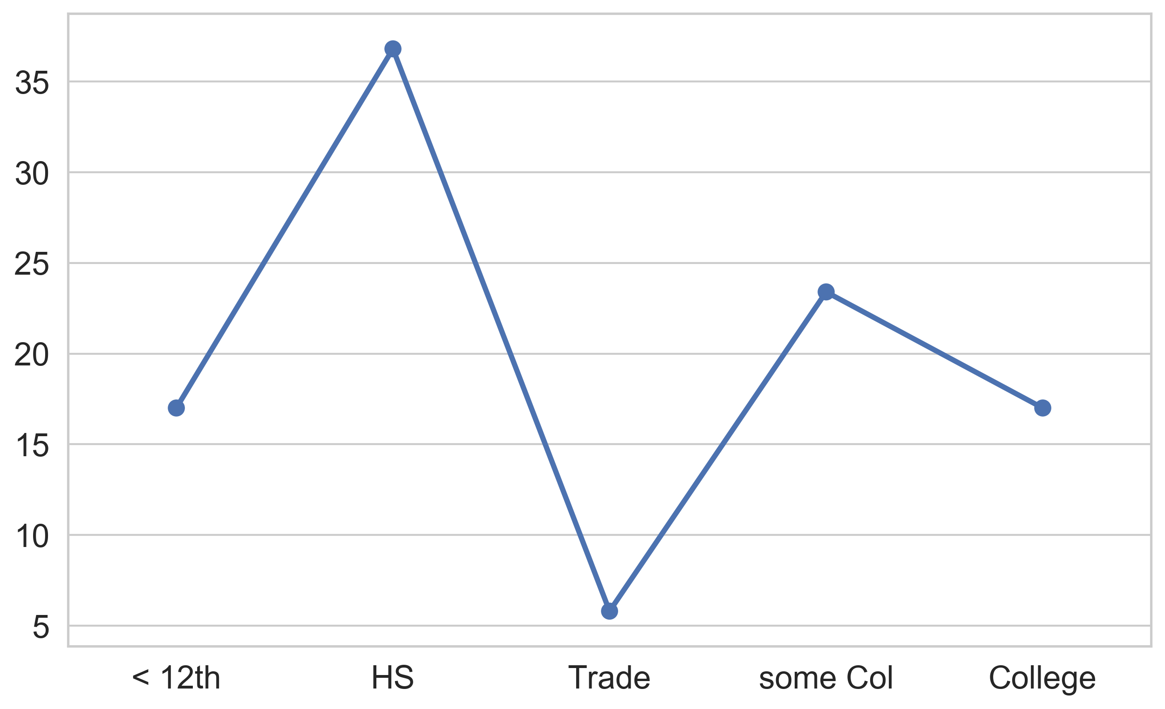
Qualitative Variable
Bar Width – has no meaning
Dot plot focuses on comparison of the values
Why do we not reorder the bars according from shortest to tallest?
Notes:
Bar chart – width of bar has no meaning
Bar chart – often prefer proportions or percentages over counts

Slide 25
Two Quantitative Variables

Slide 26
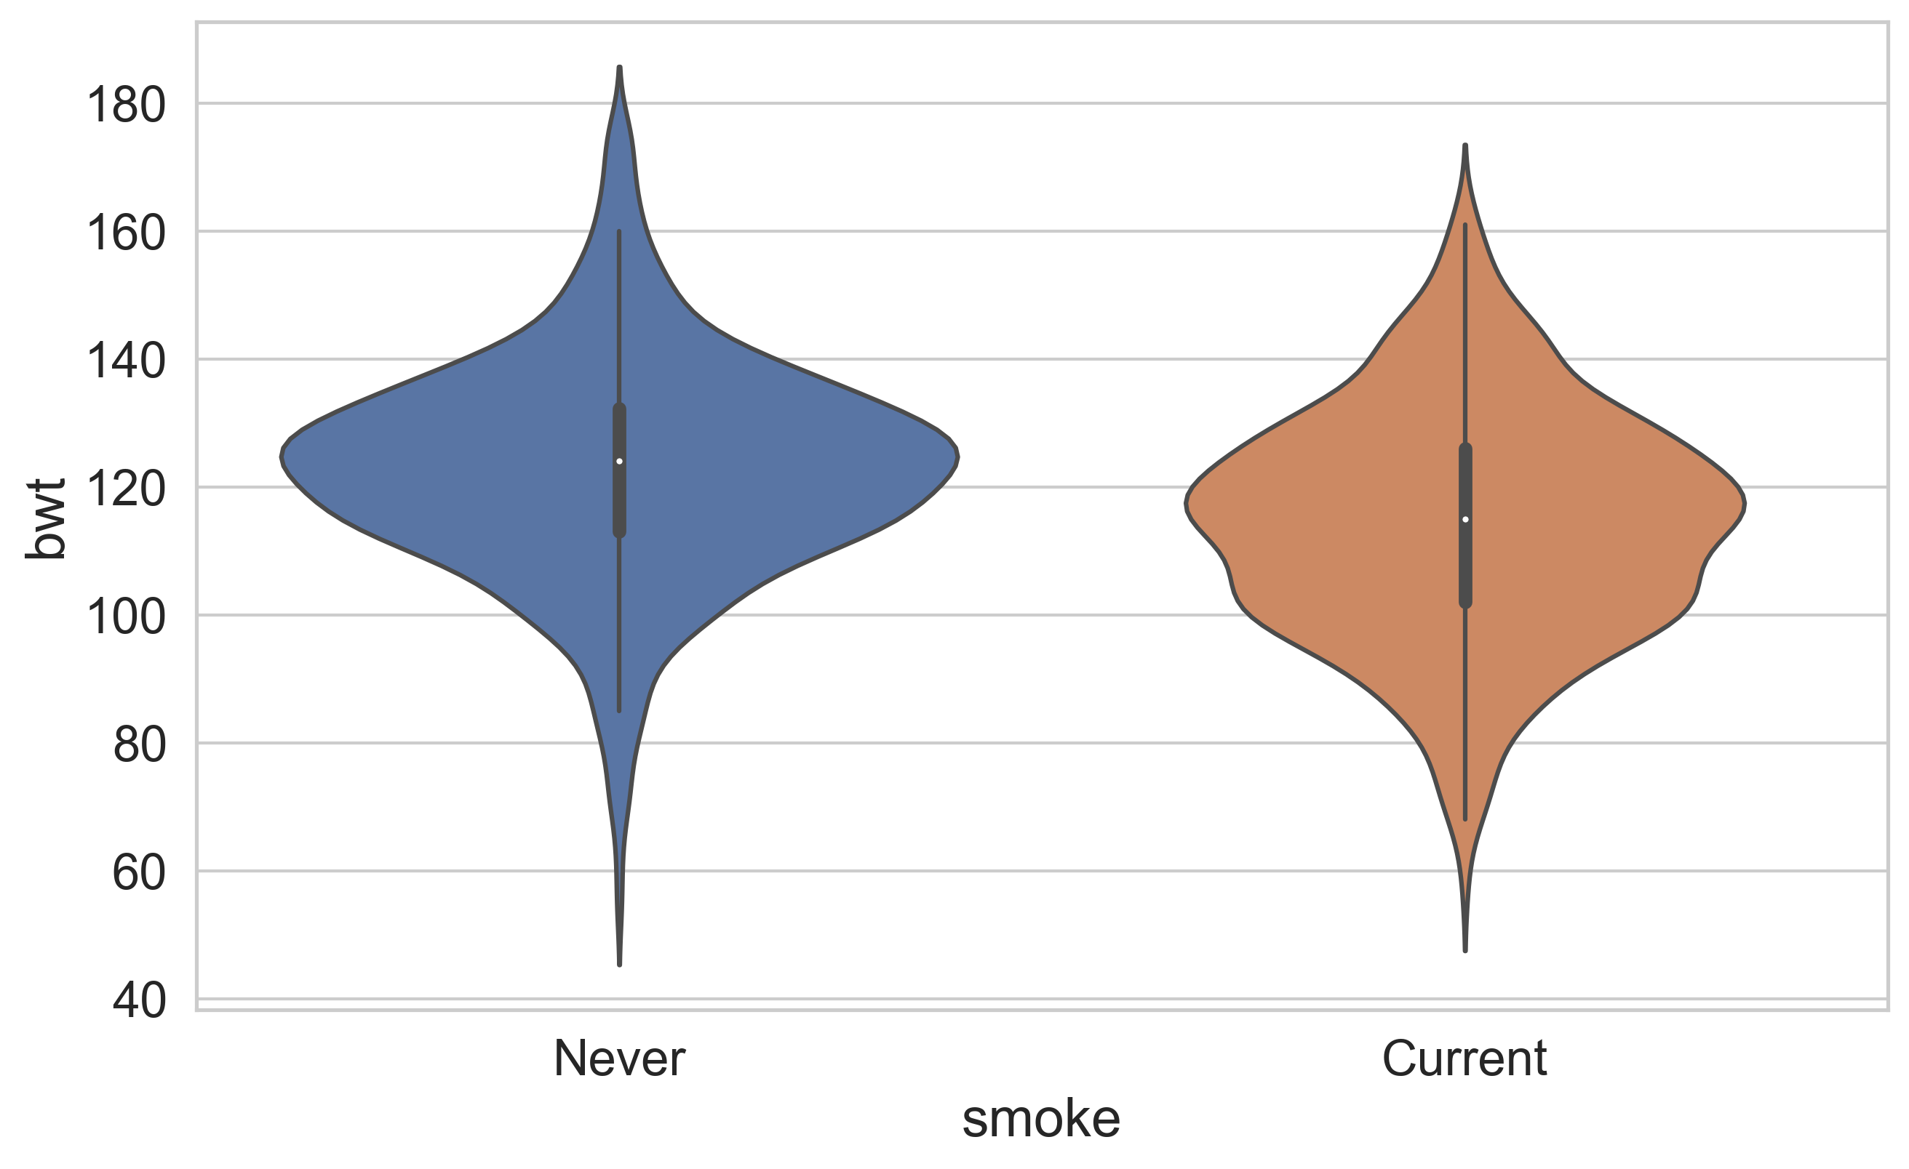
Mix Quantitative & Qualitative
Overlay Density Curves
Side-by-side violin plots

Slide 27
Two Qualitative Variables

Slide 28
Transformations

Slide 29
Why Transform Variables?
Reveal distribution of most of the observations (otherwise much of the data is squashed in a small region)
Reveal anomalies on the “other side” of the data
Numerical summaries of transformed data are better summaries of a symmetric distribution
Choose a transformation that’s simple and easily interpreted in the context of the problem, e.g., a power of 2, 3, ½, 0 (log), -1

Slide 30
Why Straighten Relationships?
Easier to uncover the form of the relationship if we can transform it to linear relationship; we see what transformation used to make it linear
Linear relationships are particularly simple to interpret & fit
Choose a transformation that’s simple and easily interpreted in the context of the problem, e.g., a power of 2, 3, ½, 0 (log), -1

Slide 31
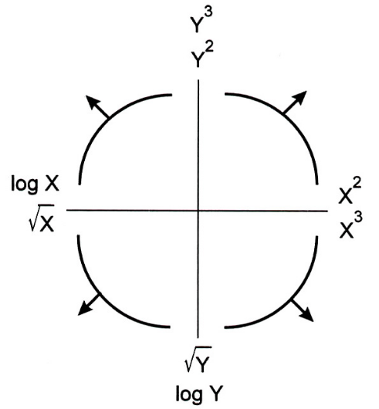
Straighten Relationships with Transformations
Tukey-Mosteller
Bulge Diagram

Slide 32
Four Examples

Slide 33
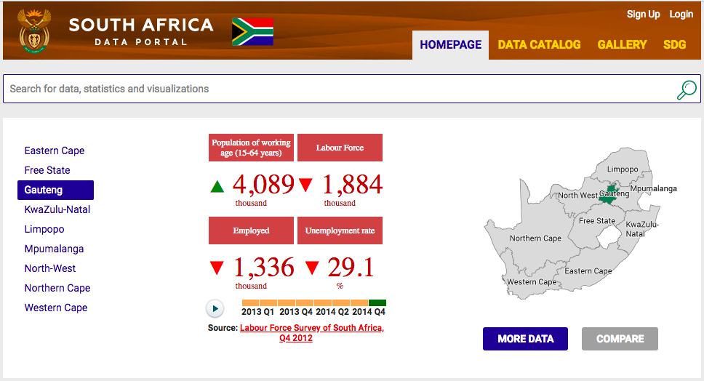
South Africa Data Portal
http://southafrica.opendataforafrica.org/fowshlc/home-page

Slide 34
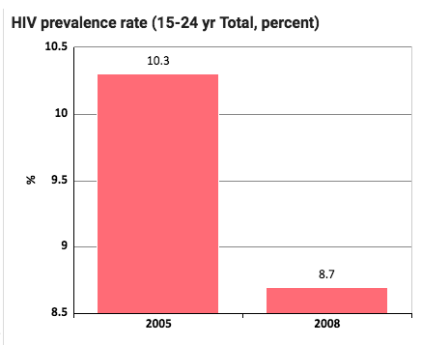
HIV Prevalence
Rate for 15-24 yr olds
Time: 2005 to 2008
How many data points are in this plot?
What’s suspicious about this plot?

Slide 35
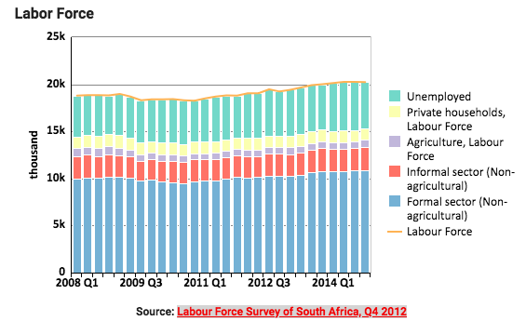
Labor Force
What is the change in unemployed over time?

Slide 36
Earnings
Bureau of Labor Statistics
Oversees scientific surveys related to economic health of the country
Current Population Survey
Collects data on the earnings
www.bls.gov - Web interface to a report generating app

Slide 37
Earnings
Which comparisons can be easily made with this plot?

Slide 38

Cherry Blossom Run
10 mile run in Washington DC each April
Organizers make results available on Web
Race results from 1999 to 2016
In 2012 nearly 17,000 runners ranging in age from 9 to 89 participated
http://www.cherryblossom.org/

Slide 39
Cherry Blossom Run
Scatter plot of run time (minutes) by age (years)
70,000 points in this plot.
What’s the relationship between run time and age?

Slide 41
Techniques

Slide 42
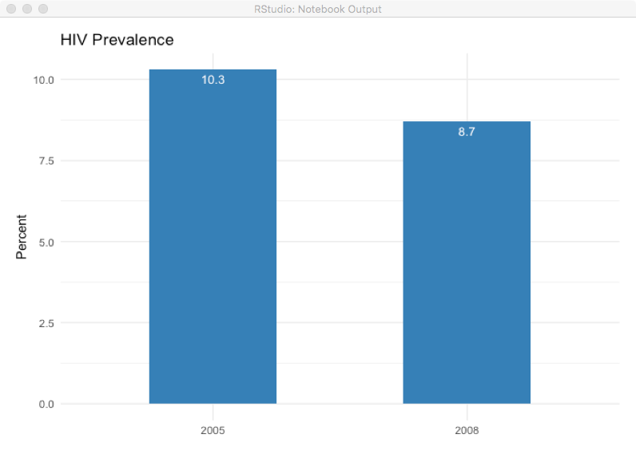
HIV Prevalence

Slide 43
Scale

Slide 44
HIV Prevalence
How does this plot change the perception of the information?
The decrease in HIV prevalence does not appear as dramatic
It is easier to see that the decrease is about 15%

Slide 45
Choosing the Scale
Choose axis limit to fill the plotting region
Determine if it makes sense to include 0
If necessary,
Zoom in to focus on region with bulk of data
Make multiple plots of different regions
Transform data to improve resolution (TBC)
Don’t change scale mid-axis
Don’t use two different scales for the same axis

Slide 46
Conditioning

Slide 47
Earnings
Emphasize the important difference…
What is the important difference?

Slide 48
Earnings
Emphasize the important difference –
Lines make it easier to see growth in gap
Placement of one point above the other makes it easier to compare males & females

Slide 49
Conditioning – Compare across subgroups
Superpose density curves, fitted curves and lines from different subgroups
Juxtapose scatter plots, histograms & keep x and y scales the same across plots to facilitate comparison
Use color and plotting symbols to represent additional variables

Slide 50
Perception - Color

Slide 51
Data Type and Color
Qualitative – Choose a qualitative scheme that makes it easy to distinguish between categories
Quantitative – Choose a color scheme that implies magnitude.
Does the data progress from low to high? Use a sequential scheme where light colors are for low values
Do both low and high value deserve equal emphasis? Use a diverging scheme where light colors represent middle values

Slide 52
Examples of Palettes
Diverging
Qualitative
Sequential

Slide 53
Perception Ranking
Based on Experiments by Cleveland and McGill

Slide 54
Most to Least Accurately Judged
Positions along a common scale
Positions on identical, nonaligned scales
Length
Angle, slope
Area
Volume, density, color saturation
Color Hue
Strip plot, rug plot, dot plot
Bar plot
Segmented bar plot
Pie chart
Bubble chart
Scatter plot with too many points, 3-d bar plots
Purple election maps

Slide 55
Area vs Length

Slide 56
Stacking
Stacked bar plots and histograms are difficult to read because the base line moves from one bar to the next
Line plots where the area between successive lines represent the measurement are very difficult to read because the base line jiggles up and down.

Slide 57
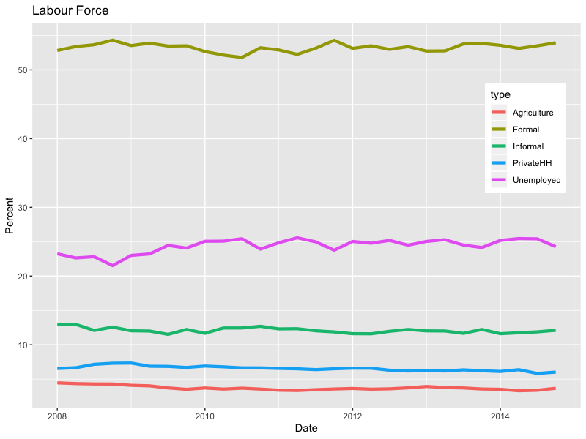
Labour Force
Not particularly exciting because they show that the participation in the various sectors has been stable over the 10-year period.

Slide 58
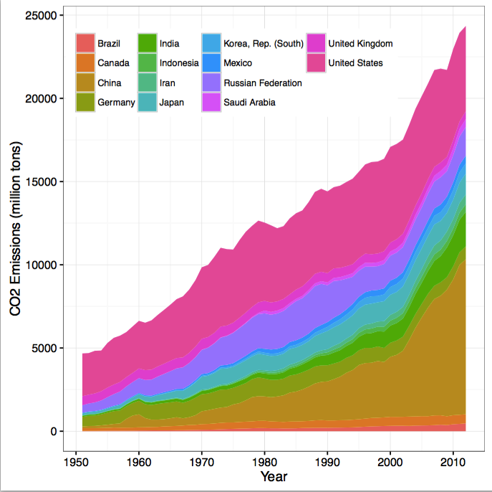
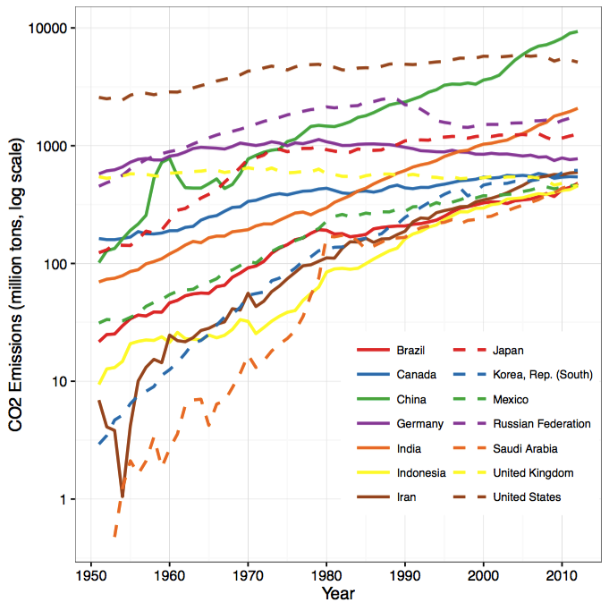
CO2 Emissions

Slide 59
Large n - Smoothing

Slide 60
Cherry Blossom Run

Slide 61
Cherry Blossom Run
Local Smoothing helps us see the typical run time for each age
We have controlled for year by making separate smooth curves for runners in each yearly race
Notice anything unusual?

Slide 62
Philosophy

Slide 63
Reveal the Data
Choose scale appropriately
Avoid having other graph elements interfere with data
Use visually prominent symbols
Eliminate superfluous material, aka chart junk
Avoid over-plotting

Slide 64
Facilitate Comparisons
Put Juxtaposed plots on same scale
Make it easy to distinguish elements of superposed plots, e.g. with color, line type
Avoid Stacking bars and lines that jiggle the baseline
Avoid angles, extra dimensions (e.g., areas rather than lines)
Don’t break the visual metaphor, i.e., if use rectangles, then area should correspond to value

Slide 65
Make a plot information rich
Describe what you see in the Caption
Add context with Reference Markers (lines and points) including text
Add Legends and Labels
Use color and plotting symbols to add more information
Plot the same thing more than once in different ways/scales
Reduce clutter

Slide 66
Good Plot Making Practice
Put major conclusions in graphical form
Provide reference information
Proof read for clarity and consistency
Graphing is an iterative process
Multiplicity is OK, i.e., two plots of the same variable may provide different messages
Make plots data rich

Slide 67
Information Visualization vs. Statistical Graphics

Slide 68
Info-Viz vs Statistical Graphics
Information visualizations tend to be grabby and visually striking
Dramatize the problem with a unique and visually-appealing image that draws casual viewer in deeper
Statistical graphics try to reveal patterns and discrepancies and make comparisons
Careful to make judicious use of all aspects, often for viewers already interested in the problem
From Gelman and Unwin’s article (2013)

Slide 69
Billion dollar o-gram

Slide 70
Word Clouds vs dotcharts

Slide 71
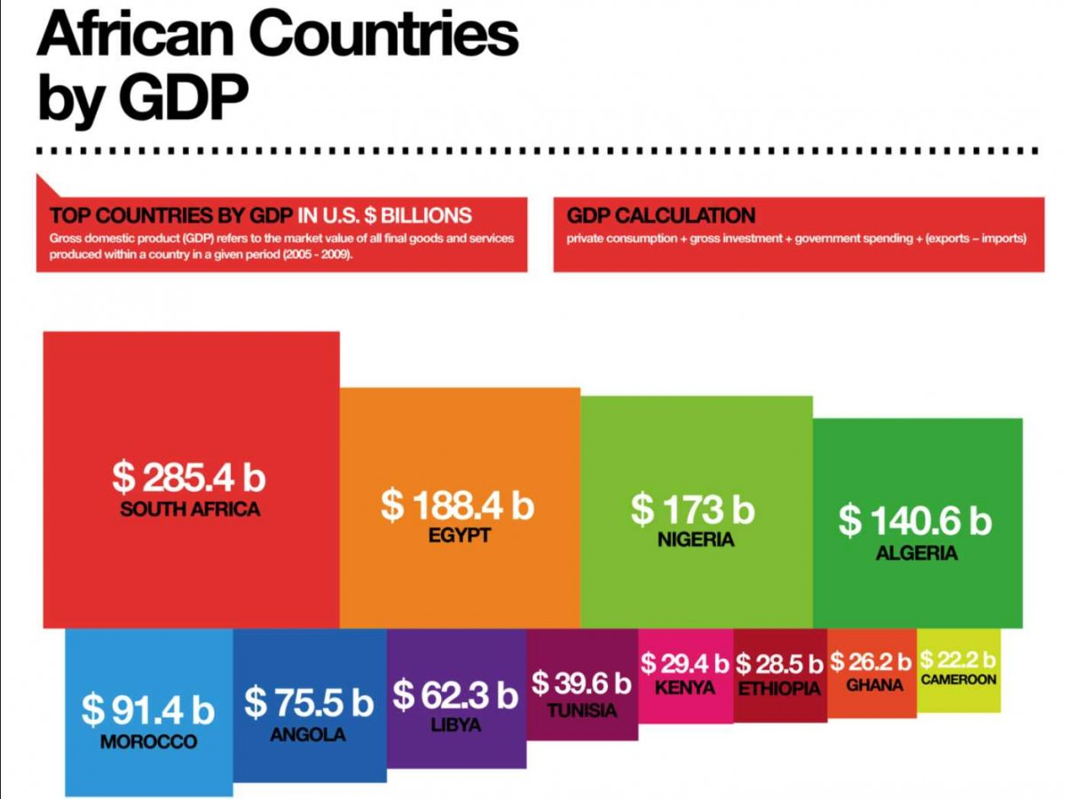
Rectangle Map vs Dot chart

Slide 72
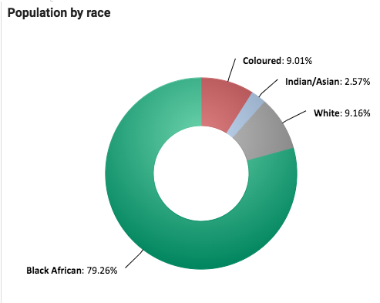
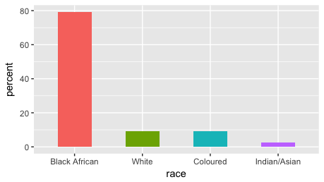
Doughnut vs Bar plot

Slide 73
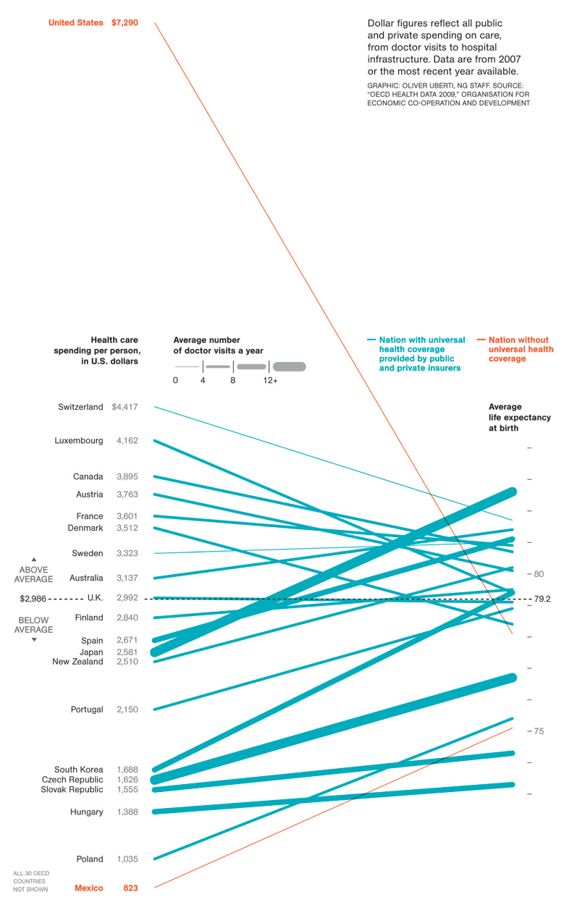
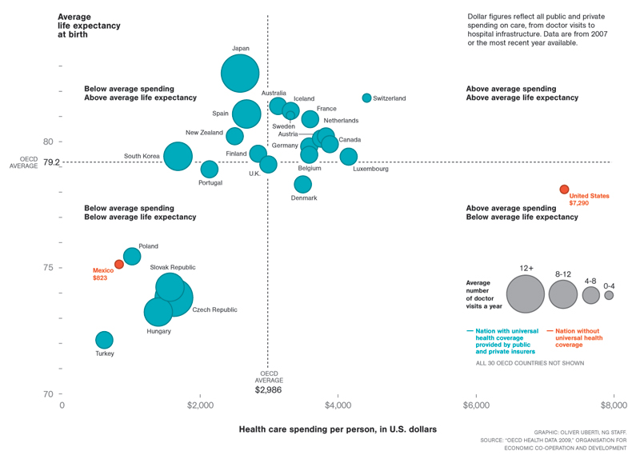
Parallel-coordinates plot vs scatterplot

Slide 74
General Graphics References
Cleveland,The elements of graphing data
Tufte, The visual display of quantitative information
Wainer, Graphic discovery: A trout in the milk and other visual adventures
Wilkinson, Grammar of Graphics
Yau, Visualize This: The flowing data guide to design, visualization, and statistics

Slide 75
R Graphics References
Murrell, R Graphics, 2nd edition
Sarkar, Multivariate data visualization with R
Wickham, ggplot2 – Elegant graphics for data analysis

